Slide 1
Image Steganography

Slide 2
Introduction of Training Company
LogicPro InfoSystem has a rich background in Software Development and continues its entire attention on achieving transcending excellence in the Development and Maintenance of Software Projects and Products in Many Areas.
Some of them are ERP, Banking, Manufacturing, Insurance and Laying Emphasis on the Multimedia Projects.
These projects are prevalent and have been distributed and implemented for clients world over.

Slide 3
Introduction of Training Company (Cont..)
The indispensable factors, which give LogicPro InfoSystem the competitive advantages over others in the market may be slated as :
· Performance
· Pioneering efforts
· Client satisfaction
· Innovative concepts
· Constant Evaluations
· Improvisation
· Cost Effectiveness

Slide 4
Introduction of Training Company(Cont..)
Vision & Mission Statement
“To help customer optimize their investments in information technology, to help them gain a competitive edge in the market place.”
Quality policy
“To help our stock holders by regularly reviewing and improving our process.”

Slide 5
Trainer
After stabilizing the LogicPro InfoSystem Products, Mr. Yogendra Verma M.Tech (CSE) started giving Software development and Counseling Services in the name of LogicPro InfoSystem, privately handled several Projects for leading Companies like Alstom, MRL and Spencers. DSEL has confronted challenges and rooted itself has a niche player in the Multimedia and the Business Software Segment. The Level of performed has been exemplary leaving it to nothing than the best of benchmark.

Slide 6
ABSTRACT
Steganography is the art of hiding the fact that communication is taking place, by hiding information in other information.
Many different carrier file formats can be used, but digital images are the most popular because of their frequency on the internet.
Different applications may require absolute invisibility of the secret information, while others require a large secret message to be hidden.

Slide 7
PROJECT SCOPE
This project is developed for hiding information in any image file. The scope of the project is implementation of steganography tools for hiding information includes any type of information file and image files and the path where the user wants to save Image and extruded file.

Slide 8
INTRODUCTION
One of the reasons that intruders can be successful is the most of the information they acquire from a system is in a form that they can read and comprehend.
Intruders may reveal the information to others, modify it to misrepresent an individual or organization, or use it to launch an attack.
One solution to this problem is, through the use of steganography.
Steganography is a technique of hiding information in digital media. In contrast to cryptography, it is not to keep others from knowing the hidden information but it is to keep others from thinking that the information even exists.

Slide 9
PROBLEM STATEMENT
The former consists of linguistic or language forms of hidden writing. The later, such as invisible ink, try of hide messages physically.
In recent years, everything is trending toward digitization. And with the development of the internet technology, digital media can be transmitted conveniently over the network.
Steganography is the art of hiding the fact that communication is taking place, by hiding information in other information. Many different carrier file formats can be used, but digital images are the most popular because of their frequency on the internet.

Slide 10
OBJECTIVE
To product security tool based on steganography techniques.
To explore techniques of hiding data using encryption module of this project.
To extract techniques of getting secret data using decryption module.

Slide 11
HARDWARE REQUIREMENTS
System : Pentium IV 2.4 GHz.
Hard Disk : 250 GB.
Floppy Drive : 1.44 Mb.
Monitor : 15 VGA Color.
Mouse : Logitech.
Ram : 1 GB

Slide 12
SOFTWARE REQUIREMENTS
Operating system : Windows XP
Coding Language : Java (Jdk 1.6), JSP, Servlet
Database : My-SQL 5.0
Eclipse Tool : Eclipse Indigo
Database GUI : Sql Yog

Slide 13
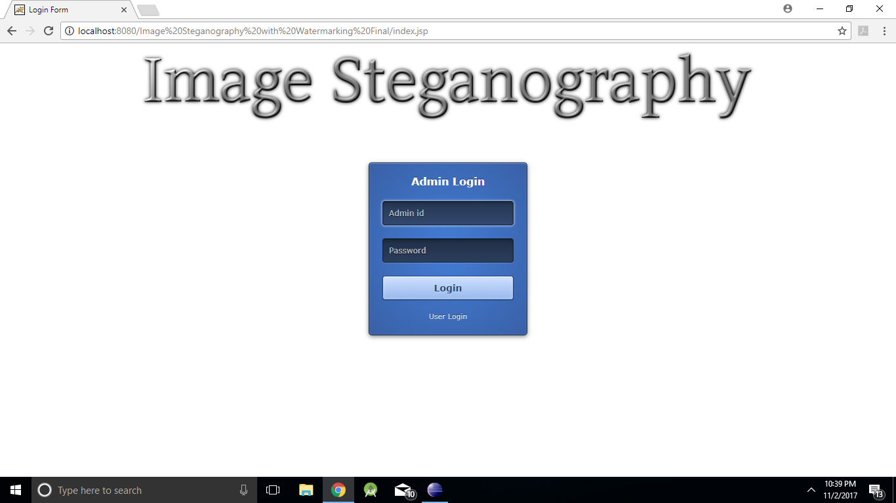
Result

Slide 14
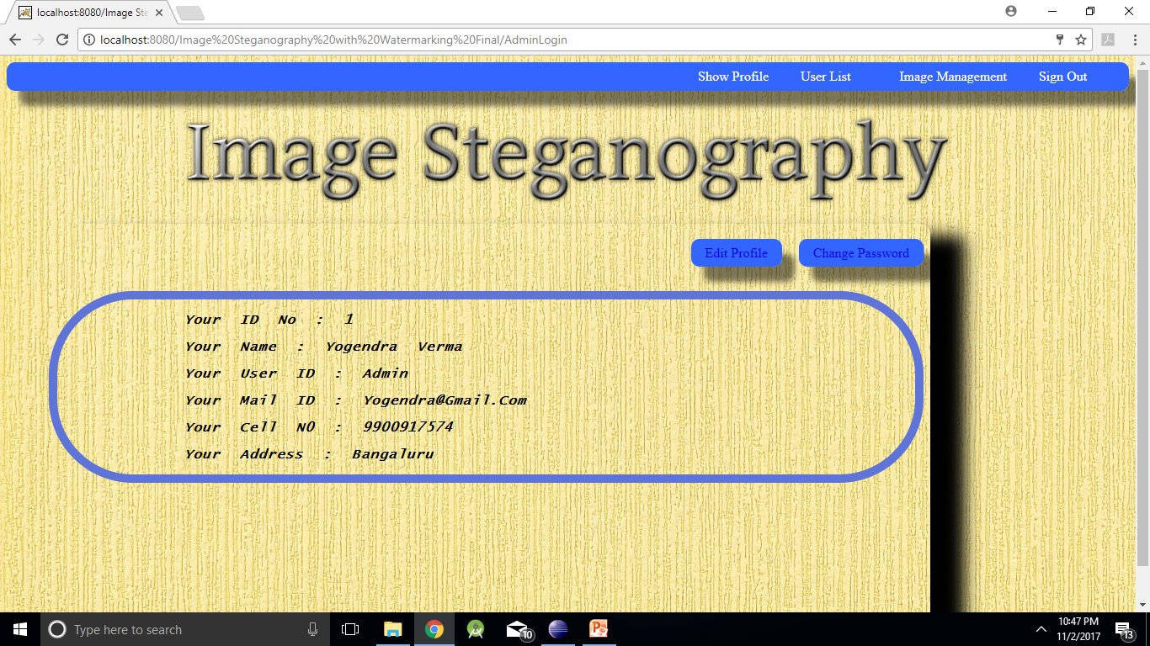
Result(cont..)

Slide 15
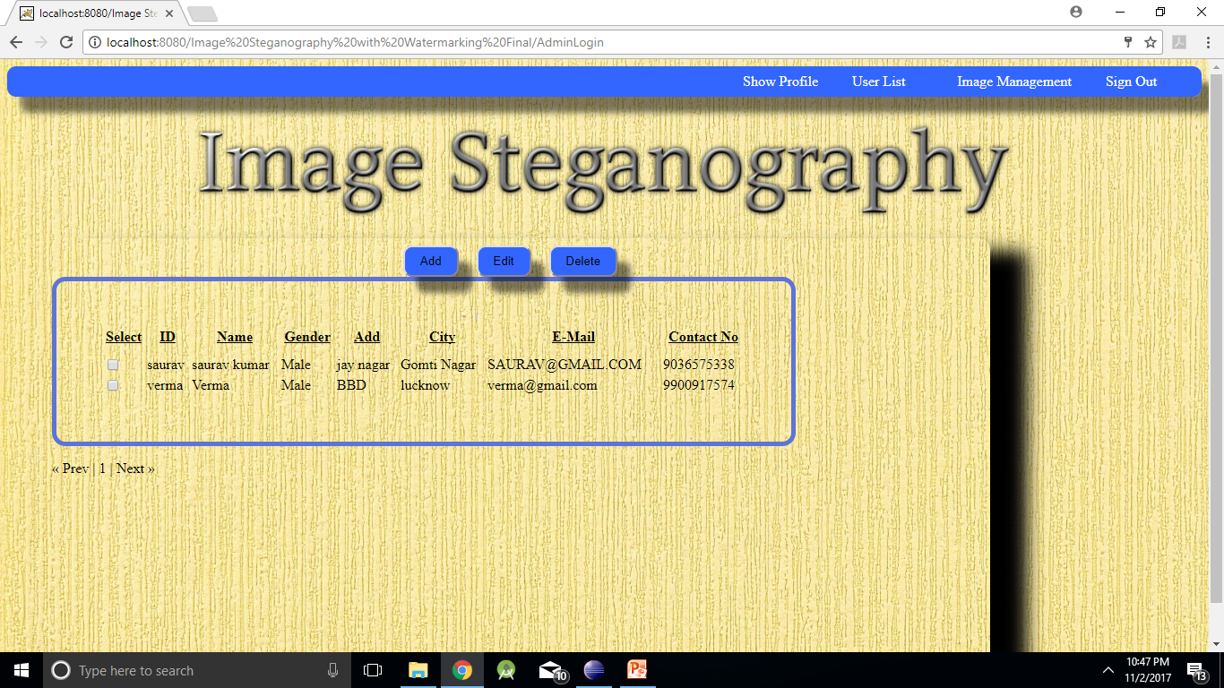
Result(cont..)

Slide 16
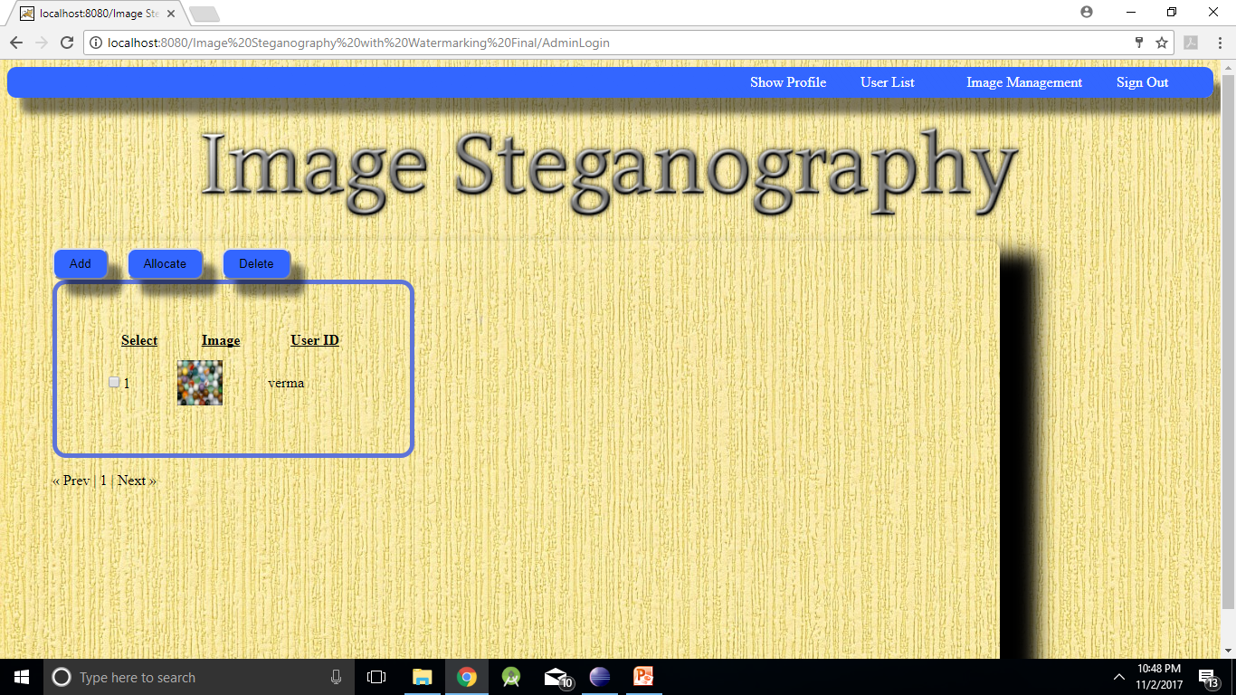
Result(cont..)

Slide 17
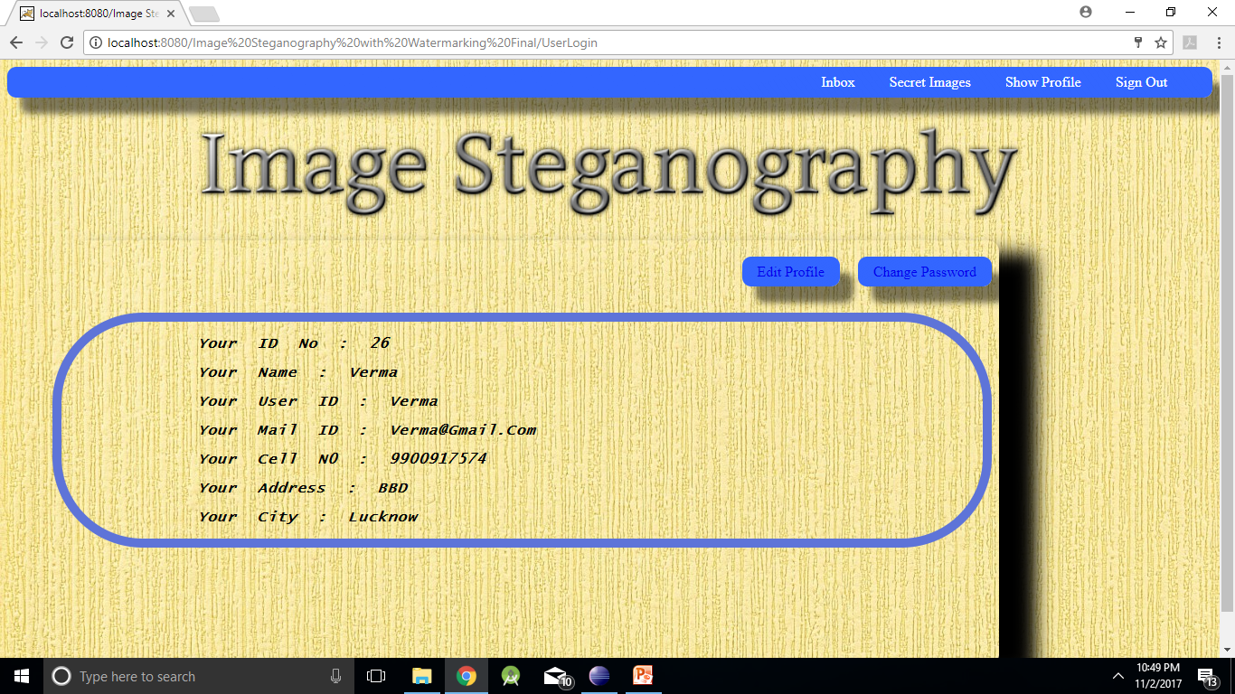
Result(cont..)

Slide 18
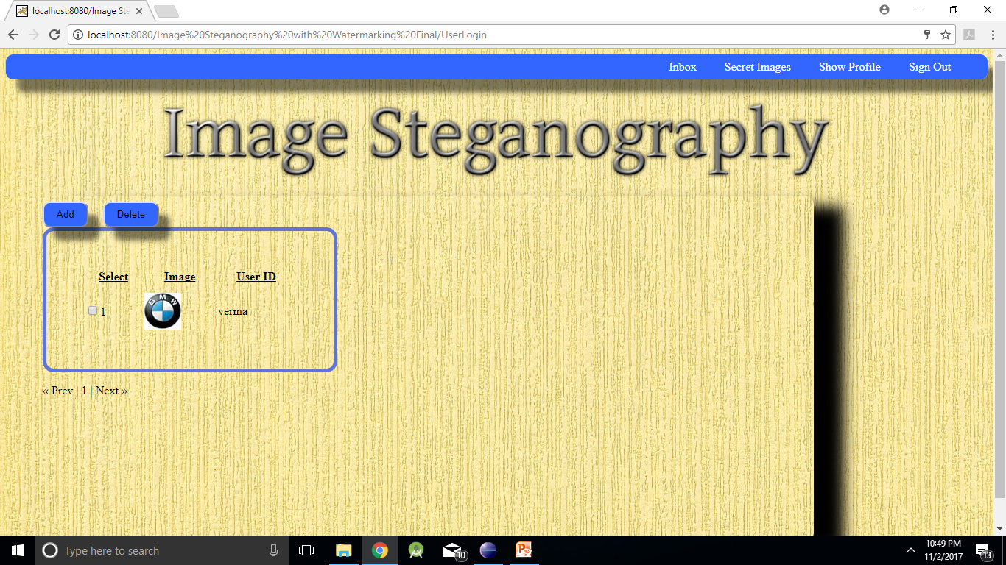
Result(cont..)

Slide 19
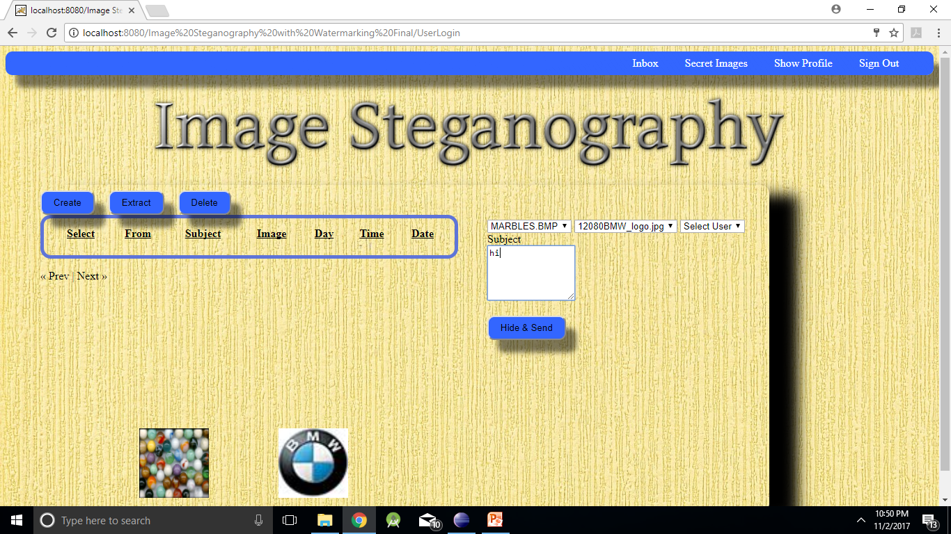
Result(cont..)

Slide 20
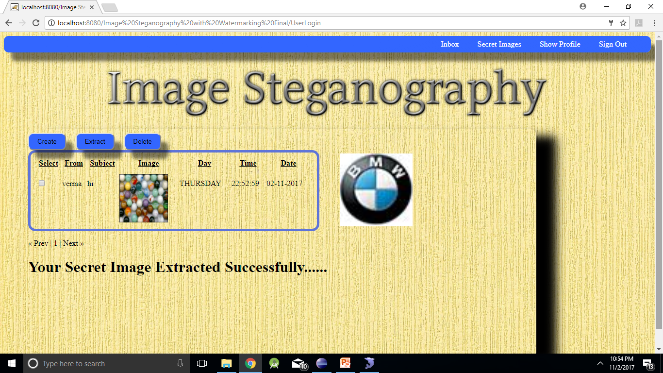
Result(cont..)

Slide 21
Conclusion
Steganography is a really interesting subject and outside of the mainstream cryptography and system administration that most of us deal with day after day.
Steganography can be used for hidden communication. We have explored the limits of steganography theory and practice.
We printed out the enhancement of the image steganography system using LSB approach to provide a means of secure communication. A stego-key has been applied to the system during embedment of the message into the cover image.

Slide 22
Thank You

